Slide 1
Winter Holiday Tag Project
Use your CodeX and radio to play “tag” with a present

Slide 2
Winter Holiday Tag
Winter holidays often involve gifts. This project is a digital version of “hot potato,” but with a gift instead of a vegetable.
Grab your CodeX device…
Let’s write some code!

Slide 3

Getting Started
You will use CodeSpace for this project.
Go to make.firialabs.com
Log in (use your account)
Go to the Sandbox
Icon on the right side bar, near the bottom

Slide 4
Getting Started
In the text editor:
Start a new file: holiday_tag
Open the text file holiday_tag_starter
Copy the code from the text file and paste it into your new file.

Slide 5
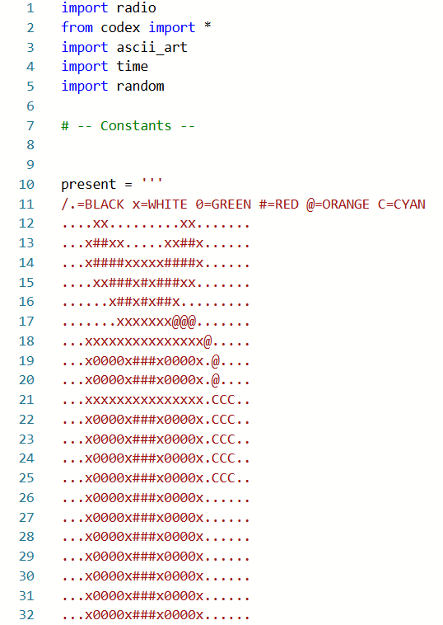
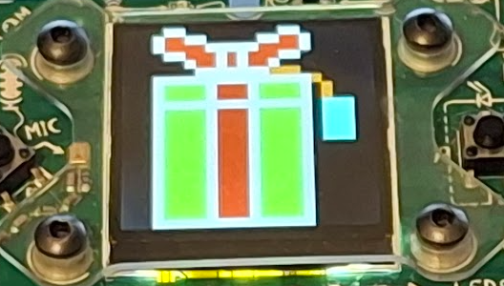
Getting Started
In the text editor:
Run the code.
You should see a gift on the CodeX display screen.

Slide 6
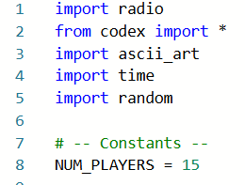
Step 1
Everyone has a present right now. But you are going to digitally “tag” the present by passing around just one.
How many people are playing the game? This is the total number of CodeX devices.
Define a constant NUM_PLAYERS.
Assign it the value of the number of players.
Your total here

Slide 7
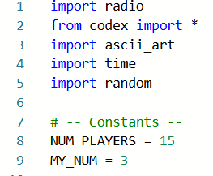
Step 1
Each player needs a unique number.
One person needs to be 1.
Another person needs to be 2.
And so on.
The last person will be the same number as NUM_PLAYERS.
Your number here

Slide 8
Step 2
Sometimes you will have the present, but most of the time you won’t.
Use a Boolean variable to keep track if you have the present or don’t have the present.
A Boolean variable can have only two values: True or False.
Use have_present as the Boolean variable.

Slide 9
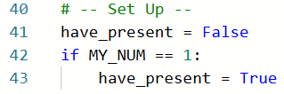
Step 2
Assign the initial value of has_present as False in the “Play Game” section.
Use an if statement to change the value if you are the first CodeX.
In Python, True and False start with a capital letter.

Slide 10
Step 3
You will display an image on the display screen frequently. Define a function for this task.
The image shown depends on the value of have_present
If have_present is True: Display the present and light the pixels
If have_present is False: Display a different image and turn off the pixels

Slide 11
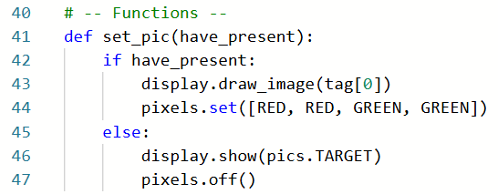
Step 3
You can choose your own image and pixel colors.

Slide 12
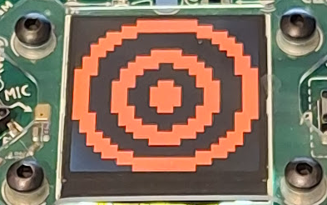

Step 3
Call the function in the “Start Game” section.
Test the program with both Boolean values for have_present.
have_present = True
have_present = False

Slide 13
Radio Communication
Each CodeX has 13 radio channels to choose from:
Channels are numbered 1 through 13
All CodeX on the same channel can easily communicate with each other. You can:
Send a message
Receive a message

Slide 14
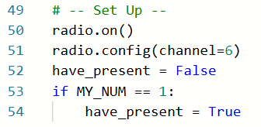
Step 4
Turn on the radio and set the channel.
Everyone in the class will be on the same channel.
This is part of the “Set Up” section.

Slide 15
Radio Communication
Messages sent using radio communication are strings.
A string is a sequence of characters, like words or sentences.
A string is the data type str.
A string is enclosed in quotation marks.
You can use double quotes “message” or single quotes ‘message’.

Slide 16
Radio Communication
You will send and receive a number.
Your number MY_NUMBER is an integer
It needs to be converted to a string for comparison.
Use the conversion function str().

Slide 17
Step 5
Write code to receive radio messages.
Use an infinite loop.
First call the function to display an image.
Then listen for a radio message.
If the message received is MY_NUM, set have_present to True.

Slide 18
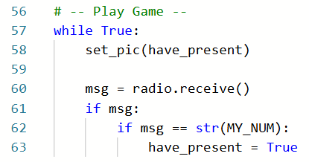
Step 5

Slide 19
Step 6
Write code to send a radio message. This code needs to be before calling the set_pic() function.
Use BTN_U to send a message.
You only send a message when you have the present.
Get a random number to send the “tag” to.
Convert the random number to a string and send.
Update have_present to False.

Slide 20
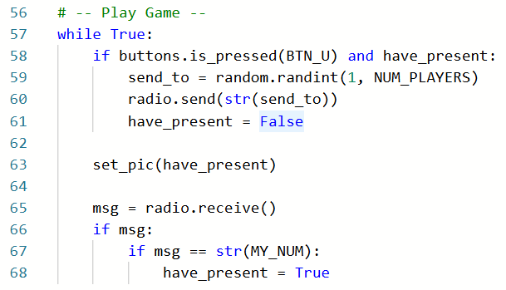
Step 6

Slide 21
Try it
Run the code
Press the
The CodeX with MY_NUM = 1 will start with the present.
Press BTN-U whenever your CodeX displays a gift.
Uh oh! It may not work they way you expect.

Slide 22
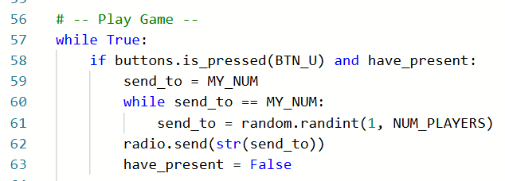
Step 7
The random number can be your own! But you can’t pass the “tag” to yourself.
Add code so that the random number is not MY_NUM.

Slide 23
Try it
Run the code.
Press the
The CodeX with MY_NUM = 1 will start with the present.
Press BTN-U whenever your CodeX displays a gift.
The “tags” will continue until you stop the program.

Slide 24
Play the Game
Ways to play:
TAG: The teacher plays music. When the music stops, the person with the present is “it.”
MUSICAL CHAIRS: The teacher plays music. When the music stops, the person with the present is out. Change the NUM_PLAYERS by one, and adjust the CodeX numbers. Play again until one person remains.

Slide 25
Variation
Each student creates their own pixel art image and displays it on their CodeX screen.
Find a JPG image and compress it to display on the CodeX screen. All students can use the same image, or they can each have their own. Change the code to display the JPG image instead of the pixel art.
Add a function to stop the program when a different button is pressed.

Slide 26
Extensions
Add to your code so the program does even more!
#1: Add code so a single CodeX can stop the game.
#2: Add a timer so the program stops automatically. The person with the gift is the winner!
#3: Add a counter and display how many times you received the gift before the game ended.

Slide 27
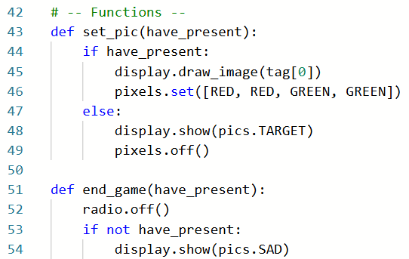
Extension #1
Add another function that displays an image when the game is over.
Notes:
Link to color picker software: https://htmlcolorcodes.com/color-picker/

Slide 28

Extension #1
Use a CodeX to be the game stopper.
Do not count this CodeX in NUM_PLAYERS
Assign the value of MY_NUM to an unlikely number.
Notes:
Link to color picker software: https://htmlcolorcodes.com/color-picker/

Slide 29
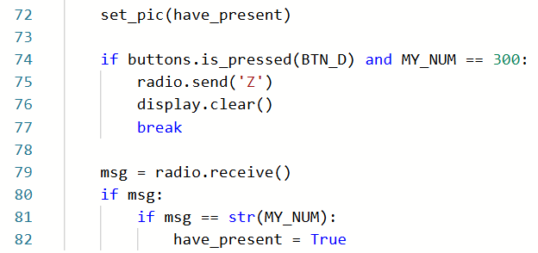
Extension #1
Add this code so the control CodeX can stop the game.
Send a non-integer signal to end the game.
Notes:
Link to color picker software: https://htmlcolorcodes.com/color-picker/

Slide 30
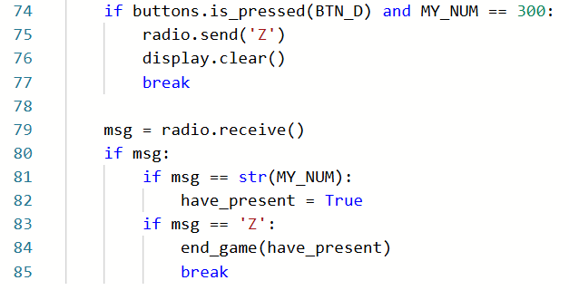
Extension #1
Add this code so the game-playing CodeX devices know the game is ending.
Notes:
Link to color picker software: https://htmlcolorcodes.com/color-picker/

Slide 31
Extension #1
Run the game.
The CodeX with MY_NUM = 1 will start with the gift.
The control CodeX will not receive the gift.
Keep passing the gift until the control CodeX presses BTN_D.
The CodeX with the gift is the winner!
Switch numbers and let the winner be the control Codex.
Notes:
Link to color picker software: https://htmlcolorcodes.com/color-picker/

Slide 32
Extension #2
Add a timer.
This code will only be executed by the first CodeX (MY_NUM = 1), but everyone should add the code so they can all be the first CodeX at some point.
No need for a separate control CodeX. Have all CodeX assigned a number and play the game.
Notes:
Link to color picker software: https://htmlcolorcodes.com/color-picker/

Slide 33
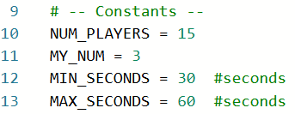
Extension #2
Select a range of seconds for your game.
A suggestion is given, but you can change the range for your specific game.
The more players you have, the longer time range you will want so everyone gets a chance to receive the gift.
Notes:
Link to color picker software: https://htmlcolorcodes.com/color-picker/

Slide 34
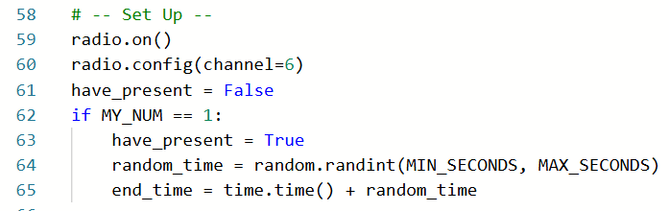
Extension #2
Add code in the “Set Up” section to calculate the ending time.
Get a random number of seconds for the game.
Use the current time + random time for the ending time.
Notes:
Link to color picker software: https://htmlcolorcodes.com/color-picker/

Slide 35
Extension #2
Modify the if statement that ends the game.
You won’t need a button press. Use the current time instead.
Call the end_game() function in the if statement.

Slide 36
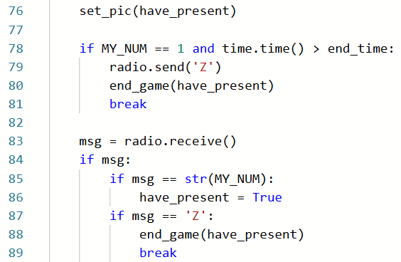
Extension #2
Only the first CodeX will check the time

Slide 37
Extension #2
Run the game.
The CodeX with MY_NUM = 1 will start with the gift.
When the random time is up, the game will stop.
The CodeX with the gift is the winner!
Switch numbers and let the winner be the first Codex.
Notes:
Link to color picker software: https://htmlcolorcodes.com/color-picker/

Slide 38
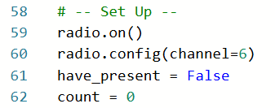
Extension #3
Add a counter for each CodeX.
Count every time your CodeX receives the gift.
Display the count at the end of the game.
Initialize the count variable in the “Set Up” section.
Notes:
Link to color picker software: https://htmlcolorcodes.com/color-picker/

Slide 39
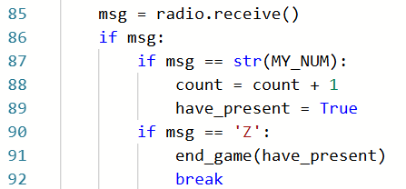
Extension #3
Increment count every time you receive the gift.
Notes:
Link to color picker software: https://htmlcolorcodes.com/color-picker/

Slide 40
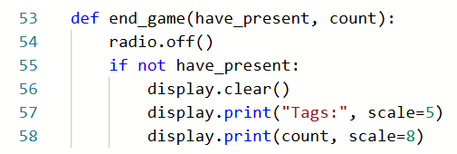
Extension #3
Add the count parameter to the function.
Display count when the game ends.
Notes:
Link to color picker software: https://htmlcolorcodes.com/color-picker/

Slide 41
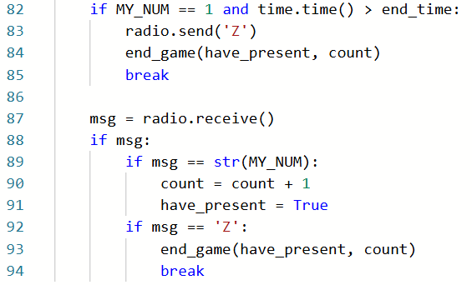
Extension #3
Add the count argument to the function calls.
Notes:
Link to color picker software: https://htmlcolorcodes.com/color-picker/

Slide 42
Extension #3
Run the game.
The count variable can be added to either Extension 1 (control CodeX) or Extension 2 (timer).
Keep track of the counts for each game. Are there some random numbers that are more frequently selected than others?
Notes:
Link to color picker software: https://htmlcolorcodes.com/color-picker/

